Slide 1

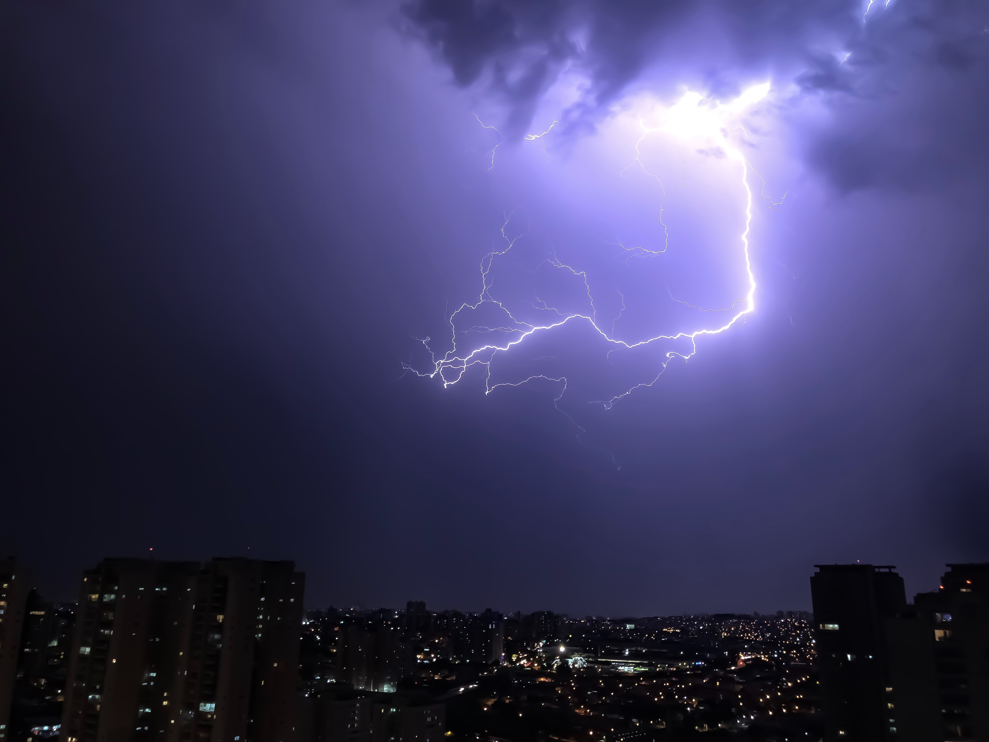

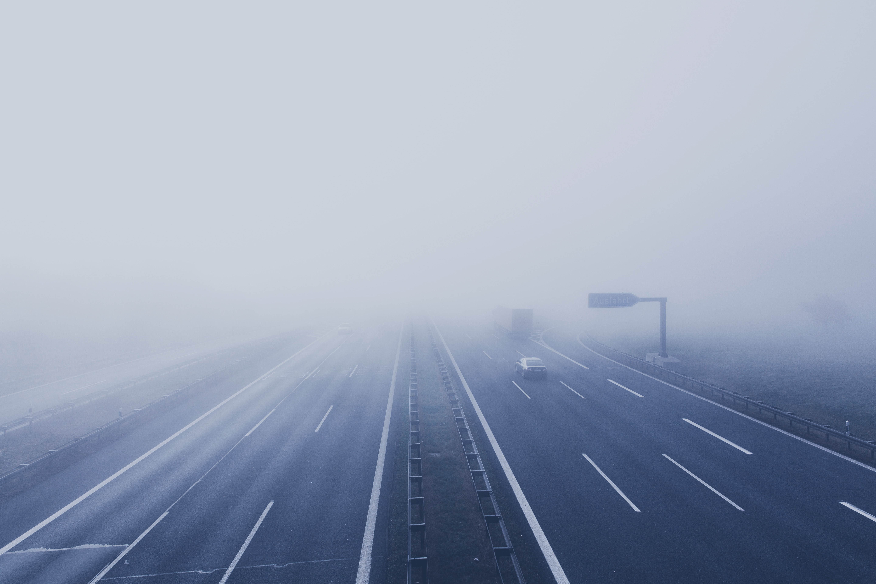
Weather Prediction Based on Meteorological and Environmental features
Group 22
Umayanagana D. M. I. EG/2020/4248
Vihanga V. M. B. P. EG/2020/4252

Slide 2
BACKGROUND
Why weather prediction is important?
Challenges in Weather Prediction

Slide 3
PROBLEM STATEMENT
Why weather prediction is important?
Challenges in Weather Prediction

Slide 4
METHODOLOGY
Descriptive statistics of the Dataset
Pre-processing
Data Splitting
Handling Imbalanced Data
SVM Model
Performance Measure of the SVM Model
Random Forest Model
Performance Measure of the Random Forest Model
Comparison of the two Models

Slide 5
Descriptive statistics of the Dataset
No of records in the dataset – 147480
No of columns – 22
No missing(null) values
Features -
time, weathercode, temperature_2m_max, temperature_2m_min, temperature_2m_mean, apparent_temperature_max, apparent_temperature_min, apparent_temperature_mean, sunrise, sunset, shortwave_radiation_sum, precipitation_sum, rain_sum, snowfall_sum, precipitation_hours, windspeed_10m_max, windgusts_10m_max, winddirection_10m_dominant, et0_fao_evapotranspiration, latitude, longitude, elevation, country, city

Slide 6
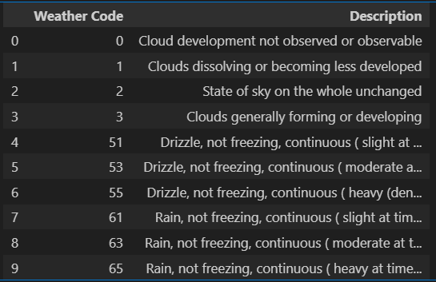
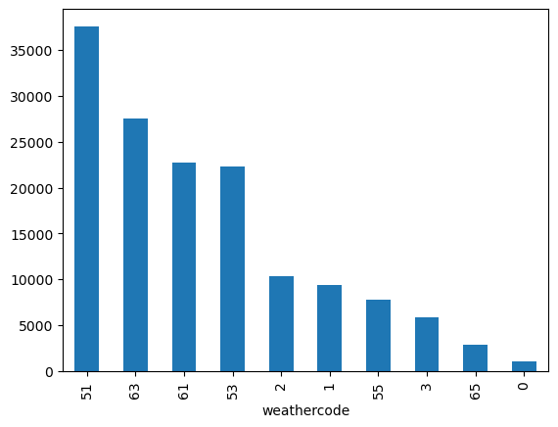
Representation of Unbalanced Data
Label – 10 (weathercode)

Slide 7
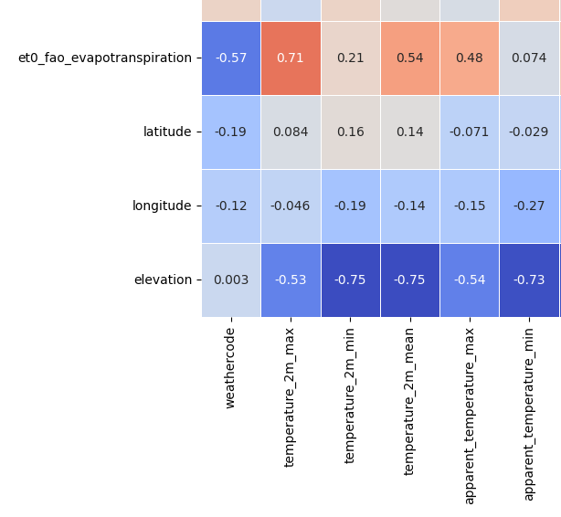
Pre-processing
Removing extra features considering correlation with the target(weathercode)
Correlation between elevation and the weather code is too low.

Slide 8
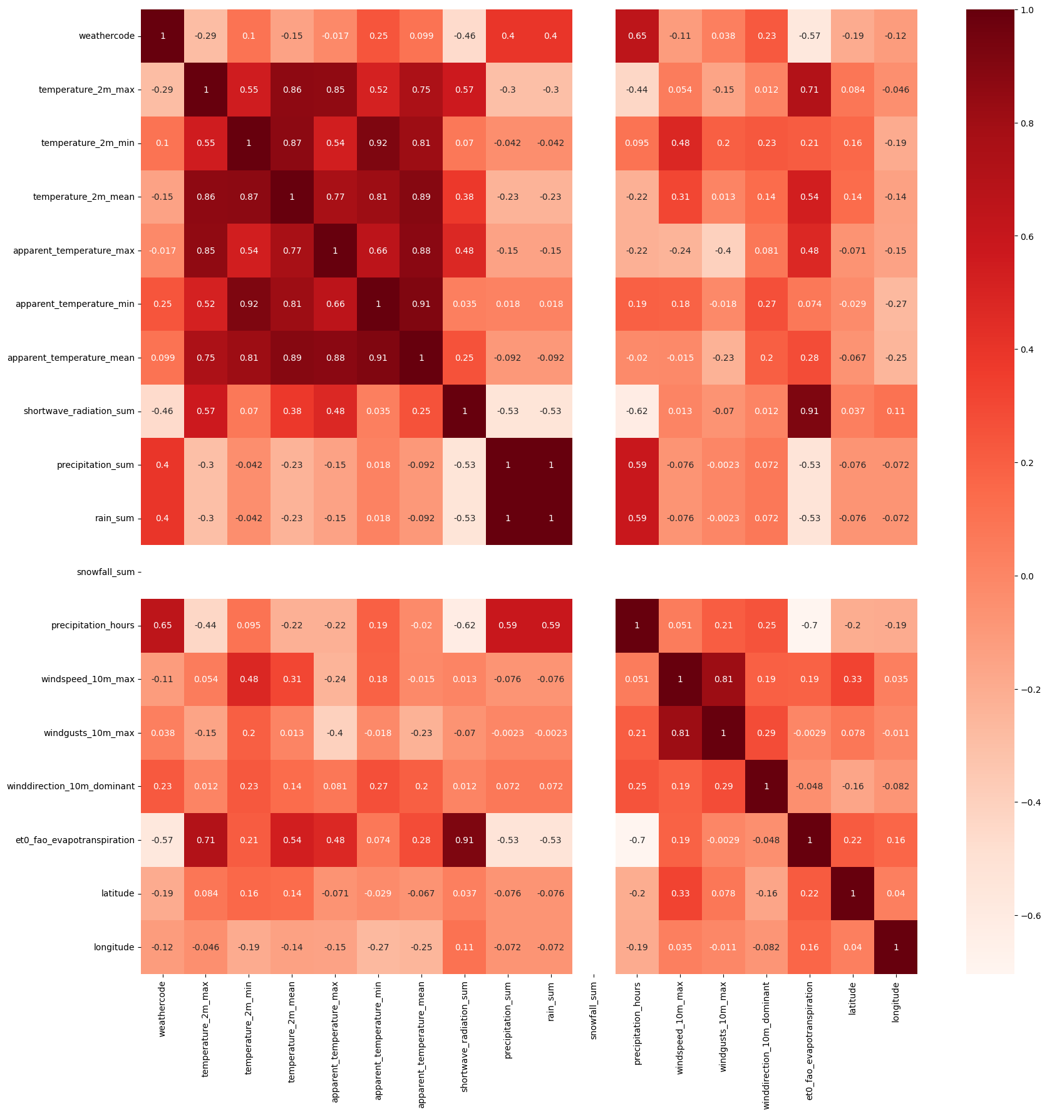
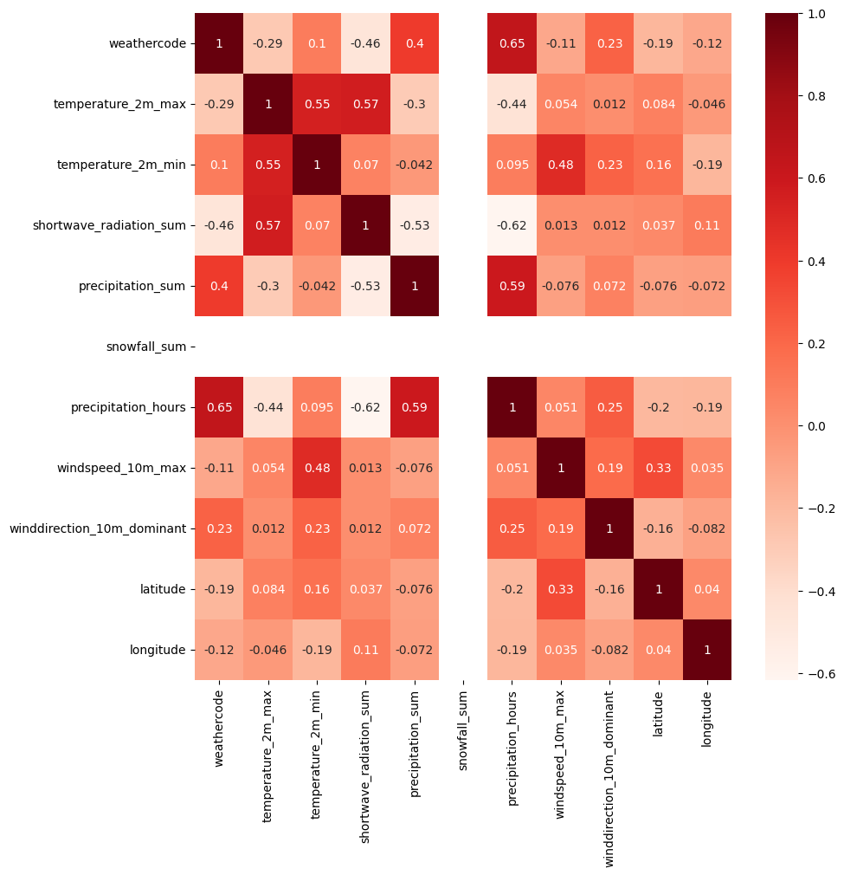
Pre-processing
Removing extra features considering correlation between features
Exclude Columns (Considering 0.7 threshold)
['temperature_2m_mean',
'apparent_temperature_max',
'apparent_temperature_min',
'apparent_temperature_mean',
'rain_sum',
'windgusts_10m_max',
'et0_fao_evapotranspiration']

Slide 9
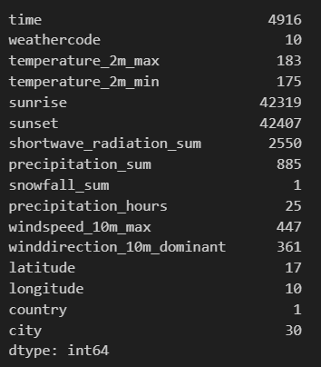
Pre-processing
Excluding column based on its unique value
Excluding factors which are not affecting to the weather
'time' , 'sunrise’ and 'sunset' do not influence the weather .

Slide 10
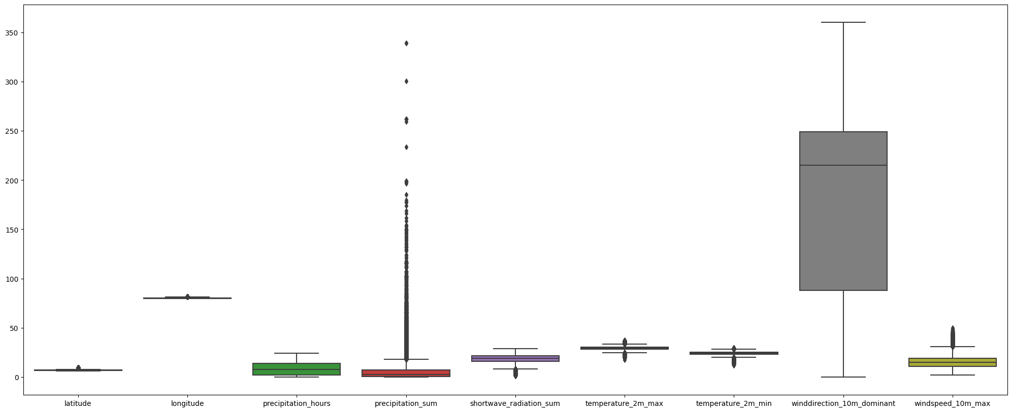
Pre-processing
Standardization, Detecting outliers and handling them using mean imputation
Before standardization

Slide 11
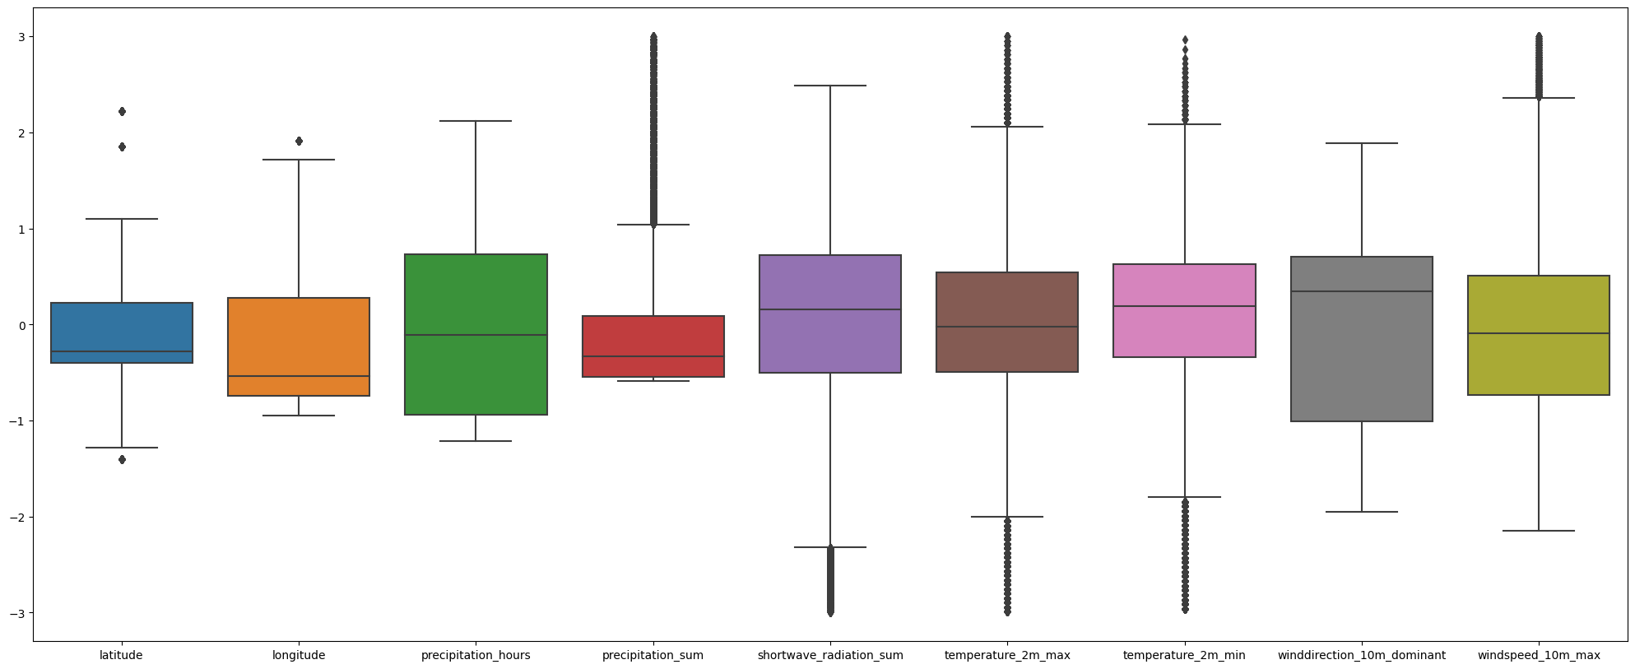
Pre-processing
Standardization, Detecting outliers and handling them using medium imputation
After Standardization and Outlier handling

Slide 12
Data Splitting
30%
70%

Slide 13
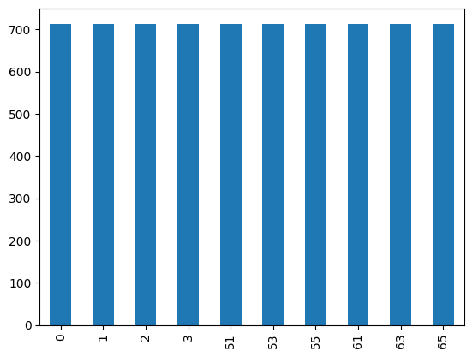
Handling Imbalanced Data
Using the SVM parameter – class_weight=‘balanced’
Data under sampling using RandomUnderSampler from imbalanced-learn library

Slide 14
SVM Model
Handling imbalanced data set using SVM parameter
Accuracy – 58.13%
Parameter used – ‘kernel = linear’
Handling imbalanced data set using imbalanced-learn library
Model B
Accuracy – 58.41%
Parameter used – kernel – ‘linear
Best params from grid search - {'C': 10, 'gamma': 0.1, 'kernel': 'rbf’}
Accuracy – 60.13%
Used 5 fold (Default value)
Accuracy is used for the performance measure
Train accuracy – 61.08%
Test accuracy - 60.13%
Model is not overfitted
Hyper parameter tuning for Model B

Slide 15
Performance Measure of SVM Model
Accuracy - 60.13%
Recall - 60.12%
Precision - 65.78%
F1 Score - 61.85%
Multiclass Log loss - 1.04

Slide 16
Random Forest Model
Handling imbalanced data set using imbalanced-learn library
Accuracy – 65.97%
Parameter used – ‘n_estimators=100’
Hyper parameter tuning
Best params from grid search – { 'bootstrap': False, 'max_depth': 30, 'max_features': 'sqrt’, 'min_samples_leaf': 2, 'min_samples_split': 2, 'n_estimators': 200}
Accuracy – 66.29%
Used 5 fold (Default value)
Accuracy is used for the performance measure
Train accuracy – 68.80%
Test accuracy - 66.29%
Model is not overfitted

Slide 17
Performance Measure of Random Forest Model
Accuracy - 66.29%
Recall - 66.29%
Precision - 70.83%
F1 Score - 67.34%
Multiclass Log loss - 0.80

Slide 18
Comparison of the two Models - Best Models
 | SVM MODEL | RANDOM FOREST MODEL
Time to train | High | Low
Accuracy | 60.13% | 66.29%
Recall | 60.12% | 66.29%
Precision | 65.78% | 67.34%
F1 - Score | 61.85% | 67.34%

Slide 19
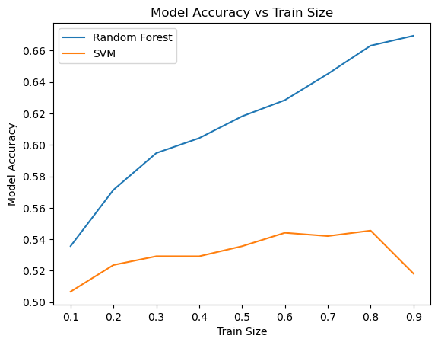
Comparison of the two Models

Slide 20
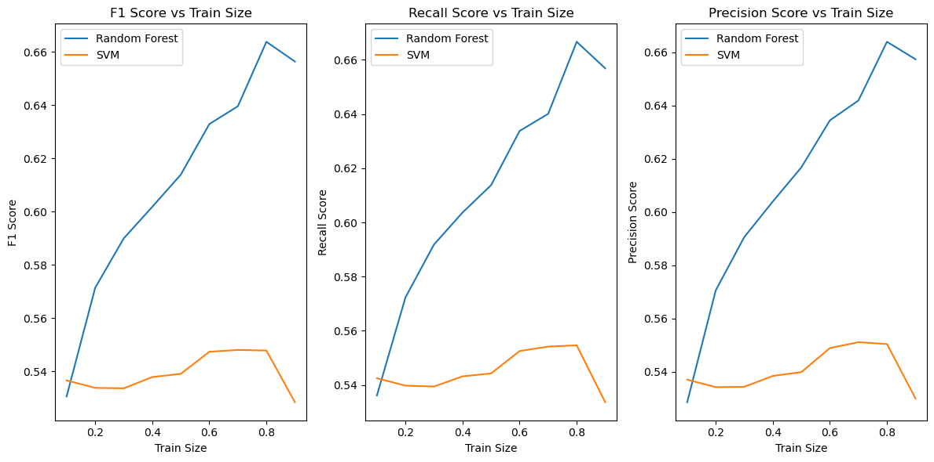
Comparison of the two Models

